Slide 1
Energy Storage For Integration of Renewable Generation at the University of California – San Diego
October 23, 2013
William Torre (University of California – San Diego
Dan Borneo (Sandia National Laboratories)
Byron Washom (University of California – San Diego

Slide 2
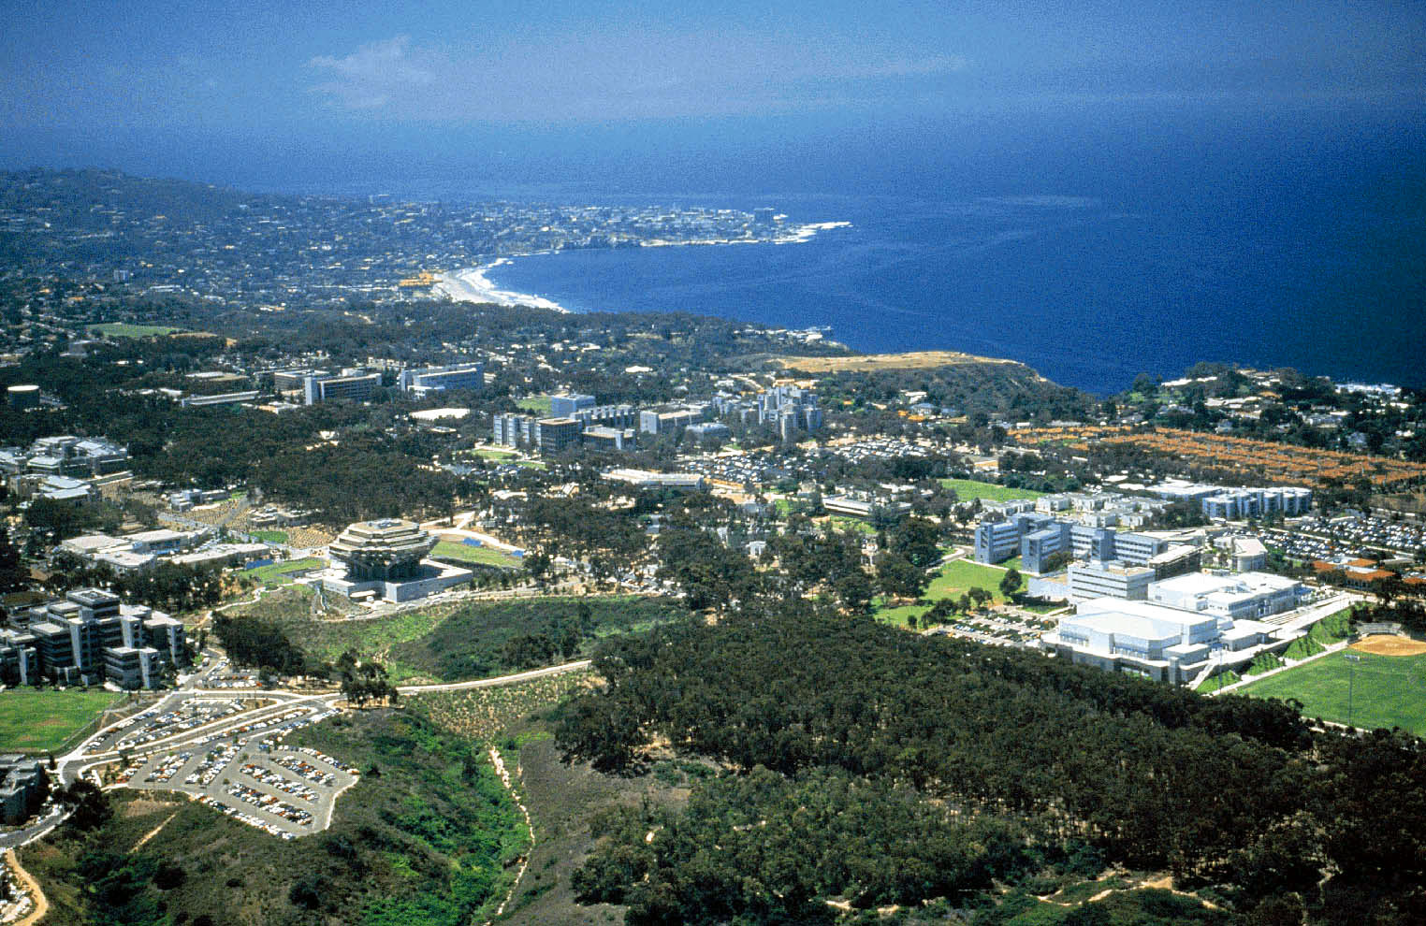
UC San Diego 42 MW Microgrid
Campus Quick Facts
With a daily population of over 45,000, UC San Diego is the size and complexity of a small city.
As a research and medical institution, we have TWO times the energy density of commercial buildings
12 million sq. ft. of buildings, $200M/yr of building growth
Self generate 92% of annual demand
30 MW natural gas Cogen plant
2.8 MW of Fuel Cells installed
2.2 MW of Solar PV installed, with another 0.8 MW planned in 2013

Slide 3
Energy Storage Projects at UCSD
30 kw, 30 kWh Sanyo/Panasonic Li-Ion battery energy storage system, integrated with 30 kW PV
125 kW, 300 kWh, ZBB Zinc – Bromine Flow Battery – CSI Demand reduction demonstration
120 kW / 65 kWh 2nd life EV Battery Test Stand NREL- CCSE
108 kW, 180 kWh BMW, demonstration of application of 2 nd use EV batteries, direct DC coupling to PV, and Fast EV DC Charging
2.5 MW, 5 Mwhr, SGIP Advanced Energy Storage RFP recently issued
730 kW, 1460 kwhr SGIP PV Integrated, five off campus sites
30 kW, Maxwell Labs, Ultracapacitors, CPV smoothing of intermittency, coupled with solar forecasting
3.8 Million Gallon Thermal Energy Storage

Slide 4
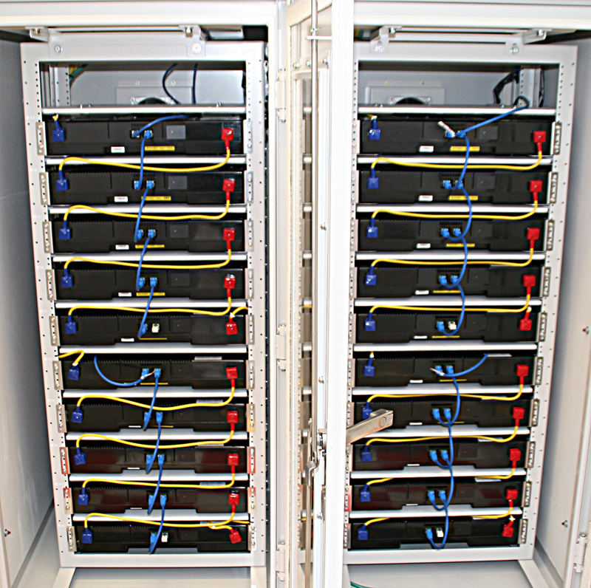
Panasonic/Sanyo PV Integration Storage Operational
30 KW / 30 kWh Lithium-ion Energy Storage Configured in 20 cassettes 1.5 kW each

Slide 5
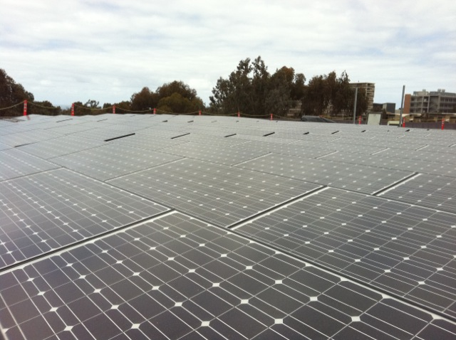
Energy Storage Integrate with PV to Demonstrate Intermittency Smoothing
Panasonic/Sanyo fully integrated 30 kW PV and 30 kWh electric energy storage
Solar Forecasting System coupled to energy storage controls to mitigate intermittency
Peak shaving to reduce the energy use/cost.
Provide stable and efficient energy.
Ancillary Function (emergency power back up for communication etc)

Slide 6
Sanyo Energy Storage PV Intermittency Smoothing

Slide 7
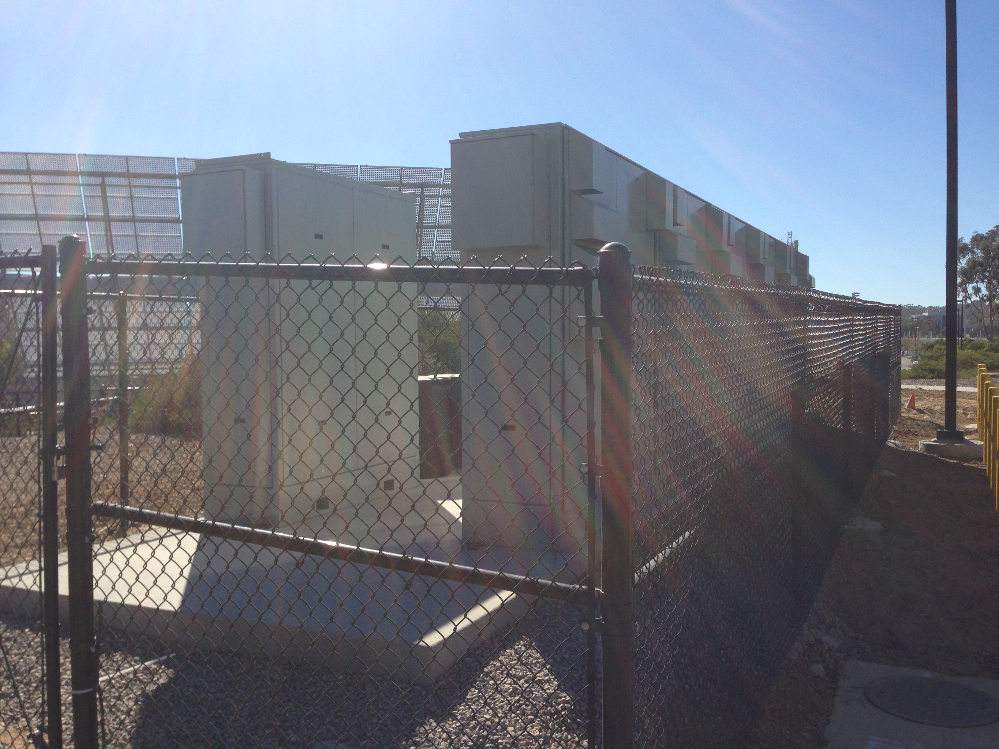
ZBB/Sunpower / DNV Kema CSI Flow Battery Demonstration
ZBB EnerStore V3 - 25 kW / 50 kWh
DC Efficiency up to 76%
Six units with 300 kWh total capacity
Directly coupled with 60 kW of roof top PV
Control system designed to reduce peak load demand requirements at East Campus Chiller Plant

Slide 8
Repurposed (2nd Life) Electric Vehicle Battery Testing
Testing four EV battery packs simultaneously with various duty cycles representing stationary storage applications
120 kW/ 60 kWh of total energy storage capacity
Test stand linked to Microgrid control system and remotely controlled.
Plug-in vehicle batteries degraded to 70-80% of original power or energy capacity are insufficient for automotive use
These “retired” batteries may still be highly capable and could be low cost source for stationary energy storage applications

Slide 9
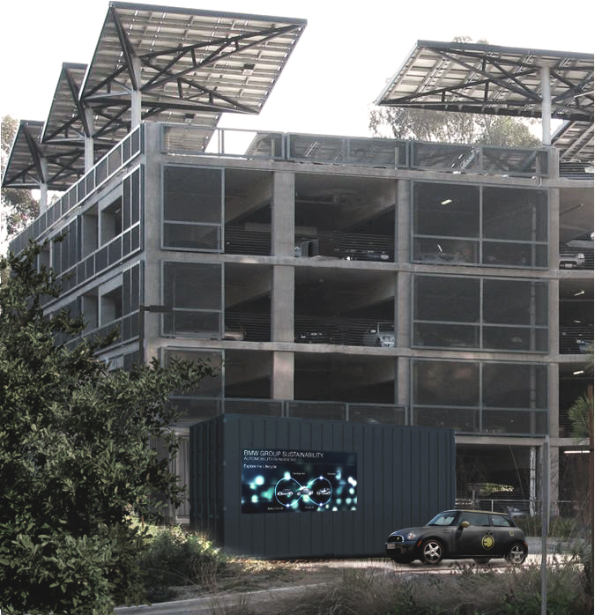
BMW 2nd Use EV Battery Energy Storage
Objective:
Objective:
Demonstrate the feasibility of integrating and controlling multiple 2nd life repurposed MINI E battery systems, with additional integration of PV solar array and the UCSD micro grid for a three year period.
Research possibilities and value:
Investigate test applications and load profiles.
Results will lead to better understanding of different use cases and possible B2U scenarios
Identify control issues related to managing multiple repurposed EV batteries with a different state of charge.
First full scale energy storage system with repurposed EV batteries..

Slide 10
2nd Life EV Battery Energy Storage Testing Stationary Energy Storage Applications
Energy Storage Applications
Electric Energy Time-shift
Electric Supply Capacity
Load Following
Area Regulation
Electric Supply Reserve Capacity
Voltage Support
Transmission Support
Transmission Congestion Relief
T&D Upgrade Deferral
Substation On-site Power
Time-of-use Energy Cost Management
Demand Charge Management
Electric Service Reliability
Electric Service Power Quality
Renewables Energy Time-shift
Renewables Capacity Firming
Wind Generation Grid Integration
Important Metrics per Duty Cycle
1)Annual operational days/hours
2)Number of cycles per given time period
3)Average DOD per cycle
4)Energy throughput per kWh of available capacity
5)Financial value per kWh
6)Value per kWh of available energy capacity and C-rate

Slide 11
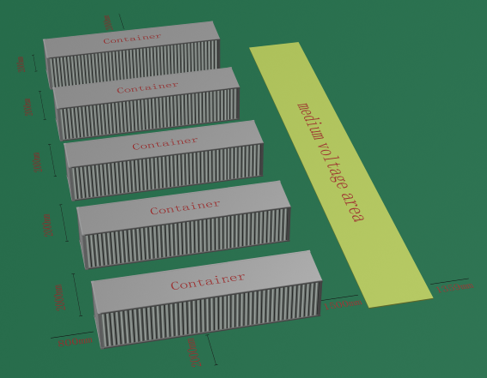
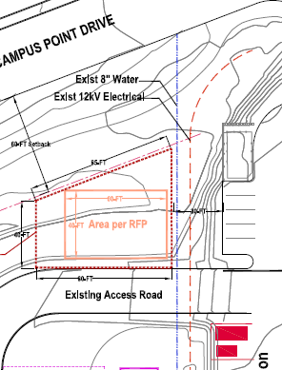
UCSD SGIP Bulk Energy Storage Project
2.5 MW, 5 MWhr, bulk energy storage
Reduce Peak Campus demand energy cost production
Integrated with PV and fuel cell and campus cooling load

Slide 12
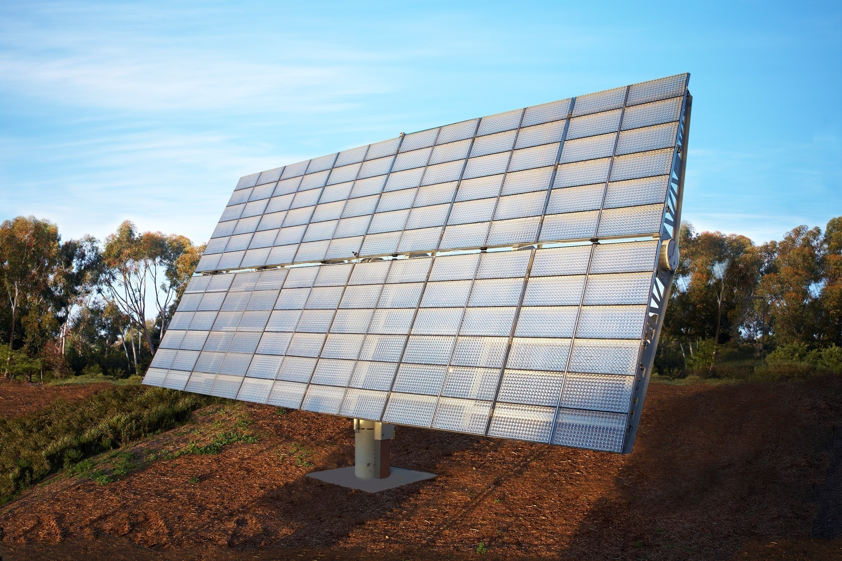
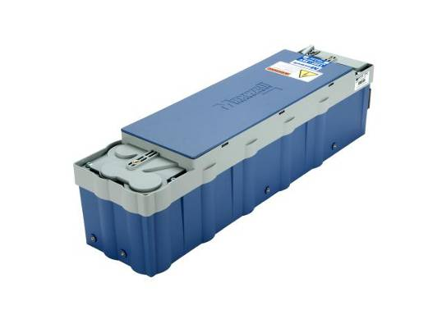
Maxwell Labs Ultracapacitor Energy Storage
Key Design Parameters
Phase I: 28 kW, 5 minute energy storage
Phase II: 250 kW, 5 minute energy storage
PV solar smoothing and firming, improve PV ramping
Coupled with 28 kW Concentrated PV
Control Strategies to be tested
Solar predictive forecasting coupled with control systems
Schedule: June, 2013 – Nov. 2015

Slide 13
Real Time Control of High Resolution Data

Slide 14
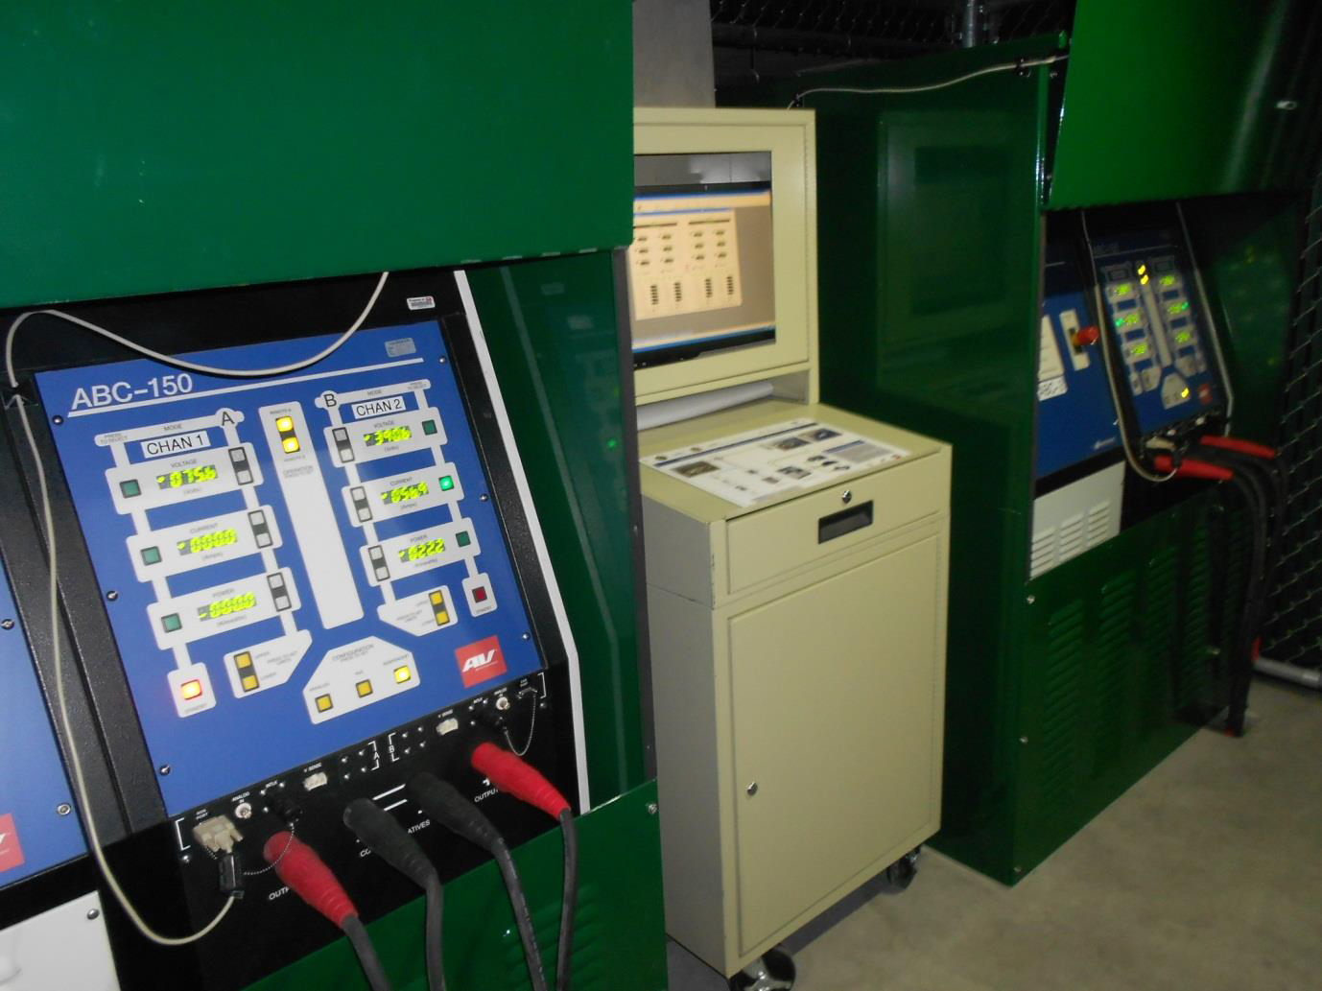
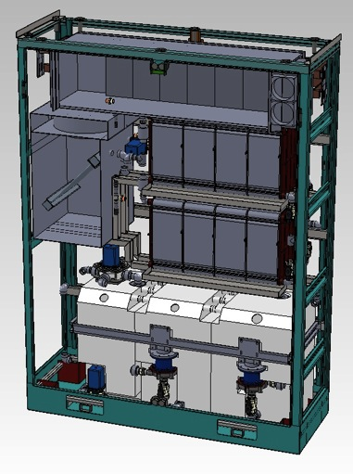
Coordinated Control and Dispatch of Distributed Energy Storage Resources To Maximize System Efficiency
UCSD Campus Load and Generation Requirements
2.5/ 5 Mwhr EnergyStorage System
2nd Life EV Battery Test Stand
Sanyo 30 kW/ 30 kWh Energy Storage
Master Microgrid Controller
BMW B2U 108 kW/ 180 kWh
ZBB 125 kW/ 300 kWh Flow Battery
Maxwell 28 kW Ultra Caps
Solar Forecasting For PV Resource Prediction

Slide 15
Summary of UCSD’s Energy Storage Program
Large diversified energy storage projects in university setting
Planning to grow collaboration with DOE/SNL on energy storage
Centralized and Distributed intelligence to control energy storage fleet dispatch
Campus energy cost savings potential significant
Living laboratory for testing and determining the benefits for various energy storage technologies
Lab To Market proven capability
Valuable research to aid integration of increasing levels of renewables
Opportunity to realize benefits in a true microgrid operational setting

Slide 16
Contact Information
William V. Torre
University of California – San Diego
858-692-2592
wtorre@ucsd.edu
Dan Borneo
Sandia National Laboratories
505-263-0363
drborne@sandia.gov

Slide 17
Acknowledgements
Thanks to the following for their support of these energy storage projects at UCSD
California Energy Commission (CEC) PIER program grant Renewable Resource Management at UCSD, 500-10-043 , Distributed Energy Storage Systems
Sanyo – Panasonic Multi-Disciplinary Research Agreement for Renewable Energy
National Renewable Energy Laboratory and the California Center for Sustainable Energy (CCSE), CEC, SDG&E, Assessment of Plug-in Electric Vehicle (PEV) Lithium-Ion Batteries in Second-Life Applications
California Public Utility Commission (CPUC) Small Generator Incentive Program (SGIP), 2.5 MW/ 5 Mwhr ES
CPUC California Solar Initiative (CSI), ZBB, Sunpower, DNV/Kema, ZBB 125 kW / 300 kWhr ES
CEC PIER, Maxwell Technologies, Ultracapacitor Project
Dr. Imre Gyuk and DOE’s Office of Electricity for their support of the Energy Storage Demonstration Projects at UCSD.

